Slide 1
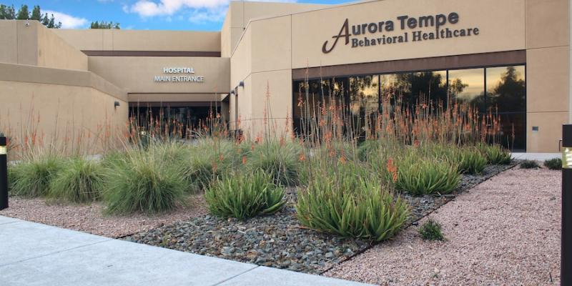
AURORA IS…
an Arizona
Behavioral Health &
Chemical Dependency
Treatment Provider

Slide 2
AURORA BEHAVIORAL HEALTH SYSTEM
Aurora Behavioral Health System is an Arizona freestanding psychiatric hospital system. We are dedicated to the wellness of individuals, their families and the community through prevention, intervention and treatment via our inpatient and outpatient services to include:
  Adult & Adolescent Inpatient Behavioral Health
  Adult & Adolescent Inpatient Detox
  Specialized Needs Unit (SNU) (inpatient)
  *ALL OUTPATIENT SERVICES CAN BE REFERRED TO FROM BOTH STEP DOWN IN PATIENT, AS WELL AS COMMUNITY REFERRALS*
  Adult Mental Health Partial Hospitalization Program (PHP)
  Adult & Adolescent Mental Health & Chemical Dependency Intensive Outpatient Services (IOP)
  Electroconvulsive Therapy (ECT)
  SNU Partial Hospitalization Program (PHP) *coming soon*
Notes:
Aurora originated in September of 2000 and is privately owned by a psychiatrist. Besides our two hospitals here in the Phoenix area, we also have four facilities in southern California and one in Chicago. The company is also in the process of opening a hospital in northern California and possibly one or two in the Las Vegas area. One of the great things about working with and for Aurora is that each facility has the freedom and flexibility to run its operation to meet the needs of the community. As you know, our San Diego hospital has had a military unit for four years, and we saw the need to emulate their service here locally in the valley. And, we are mirroring our program after our San Diego’s program.

Slide 3
AURORA BEHAVIORAL HEALTH SYSTEM
Two Hospitals
  Aurora West in Glendale
    100 beds (adults and adolescents)
  Aurora East in Tempe
    138 beds (adults and adolescents)
  Both hospitals are level 1, acute care facilities.
  Both hospitals are licensed by the State of Arizona.
  Both hospitals are accredited by The Joint Commission and are certified by CMS to accept Medicare and Medicaid patients.

Slide 4
AURORA treats the following
Severe Mental Illness (SMI)
Suicidal & Homicidal Ideation
Detox & Substance Abuse
Mood Disorders (Depression, Bipolar)
Anxiety Disorders (General Anxiety, Panic Disorders, Agoraphobia )
Psychotic Symptoms (hallucinations, delusions, schizophrenia)
Medication Stabilization / Medication Adjustments

Slide 5
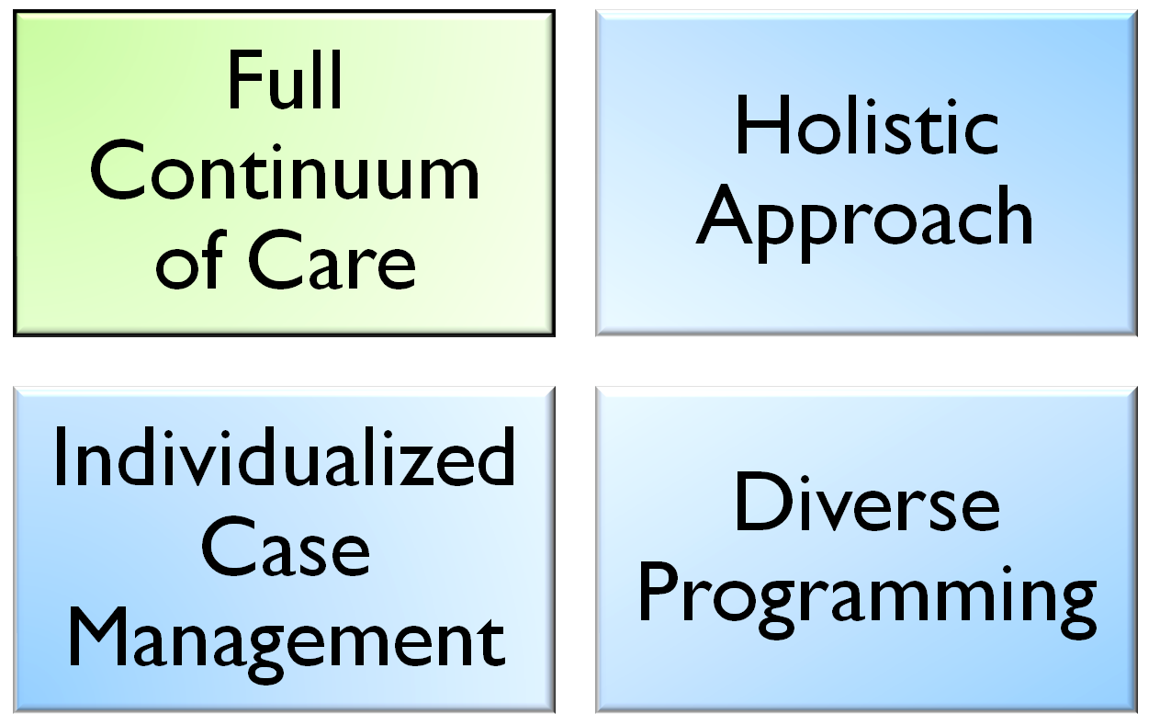
WHAT AURORA OFFERS

Slide 6
Full continuum of care
Aurora
Inpatient
PHP
IOP
Community Resources

Slide 7
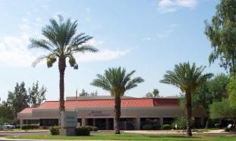
INPATIENT LEVEL OF CARE
Adults (SMI, general mental health, detox and chemical dependency)
Specialized Needs Unit (ages 8-17 with an intellectual disability, 30-90 day stay)
Adolescent (mental health, detox and chemical dependency)
Severe, acute symptoms
Obsession with death; plans for suicide
Poor self-care; ceased to function
May be having hallucinations
Active psychosis
Requires 24/7 supervision
AVERAGE LOS
  Adult: 7-10 days
  Adolescents (12-17): 7-10 days

Slide 8

ECT TREATMENT
Providers include board certified and recertified ECT psychiatrist and board certified anesthesiologists. Team has worked together for over a decade.
For medication/treatment resistant patients
Family member/friend can meet with the ECT psychiatrist and anesthesiologist before each ECT treatment.
Family member/friend can be with patient up until the time of anesthesia.
ECT psychiatrist available to each patient after treatment for questions/concerns.
Can treat ages 12+

Slide 9
OUT Patient LEVEL OF CARE
  Partial Hospitalization Program (PHP)
    Adult Mental Health
    Adult Chemical Dependency
    Adult Cooccurring
    (SMI, general mental health, chemical dependency, and cooccurring)
  Intensive Outpatient Program (IOP)
    Adult Mental Health
    Adult Chemical Dependency
    Adult Cooccurring
    Adolescent Mental Health (ages 12-17)
    Adolescent Chemical Dependency (ages 12-17)
    Adolescent Cooccurring (ages 12-17)
    (SMI, general mental health, chemical dependency, and cooccurring)
Notes:
In summary…

Slide 10
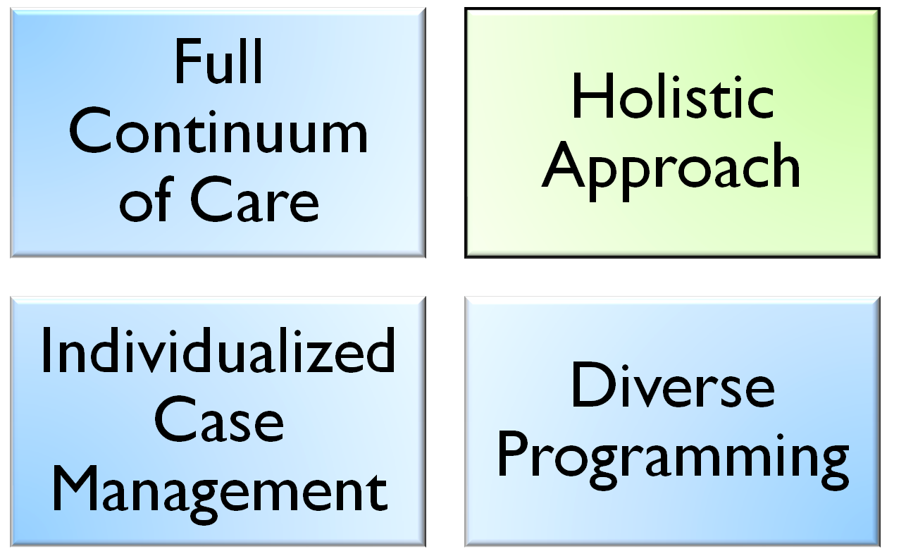
WHAT AURORA OFFERS

Slide 11
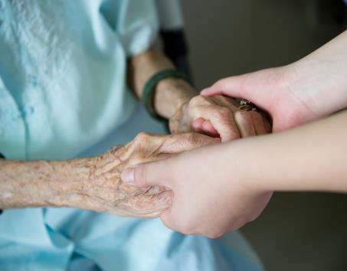
Holistic approach to treatment
Healing Environment
MIND
BODY
SOUL

Slide 12
Holistic approach to treatment, continued…
Psychiatric Assessment and Treatment
Health Assessment and Nutritional Guidance
Full Time Medical Staff
Chaplain Services Program
Adjunctive Therapy
  Art Therapy
  Music Therapy
  Equine Therapy
  Horticulture Therapy
  Recreational Therapy
  Life Skills
Notes:
--treatment planning
--multi-disciplinary approach
--nutrition… nutritionist on staff; all meals made fresh daily; accommodate any type of diet; pt sat scores
---CLICK when you get to adjunctive therapy

Slide 13
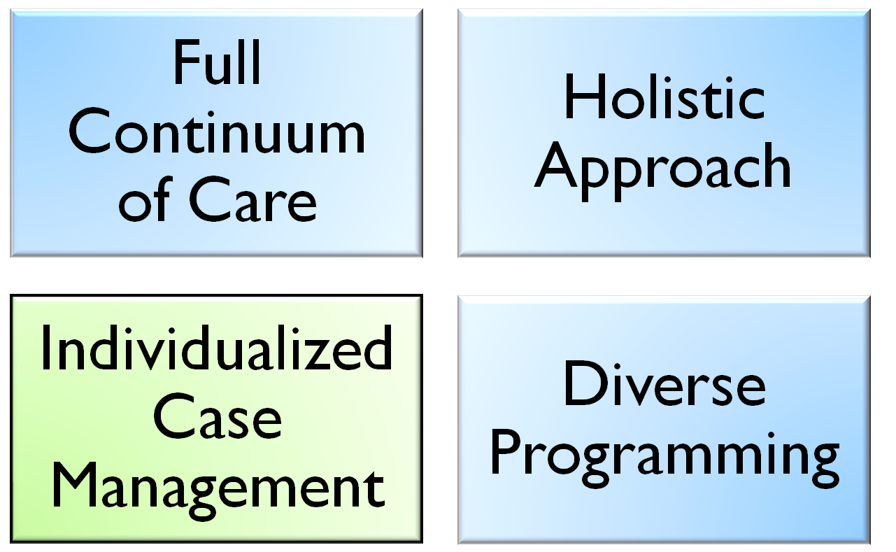
WHAT AURORA OFFERS

Slide 14
INDIVIDUALIZED CASE MANAGEMENT
Each patient is assigned a social worker.
Social Worker is main point of contact for all professionals and family members actively involved in patient’s care.
All members of the Social Work department have in-depth knowledge of resources and aftercare planning.

Slide 15
Clinical modules and unit programming
High level therapeutic support
Adolescent and adult groups utilize CBT (Cognitive Behavioral Therapy), Mindfulness and DBT (Dialectical Behavioral Therapy) as the evidence based clinical models.
Modules have been created to teach self regulation skills and problem solving.
Each unit consists of three primary staffing: Behavioral Health Technicians (BHT), Registered Nurse (RN), Patient Care Manager (PCM, Therapist)

Slide 16
Core Concepts
CORE CONCEPTS
Provide a safe and therapeutic environment.
Develop Self-Regulation Skills.
Create an ongoing Stanley Brown Safety Plan.
Teach patients to identify their relapse triggers.

Slide 17
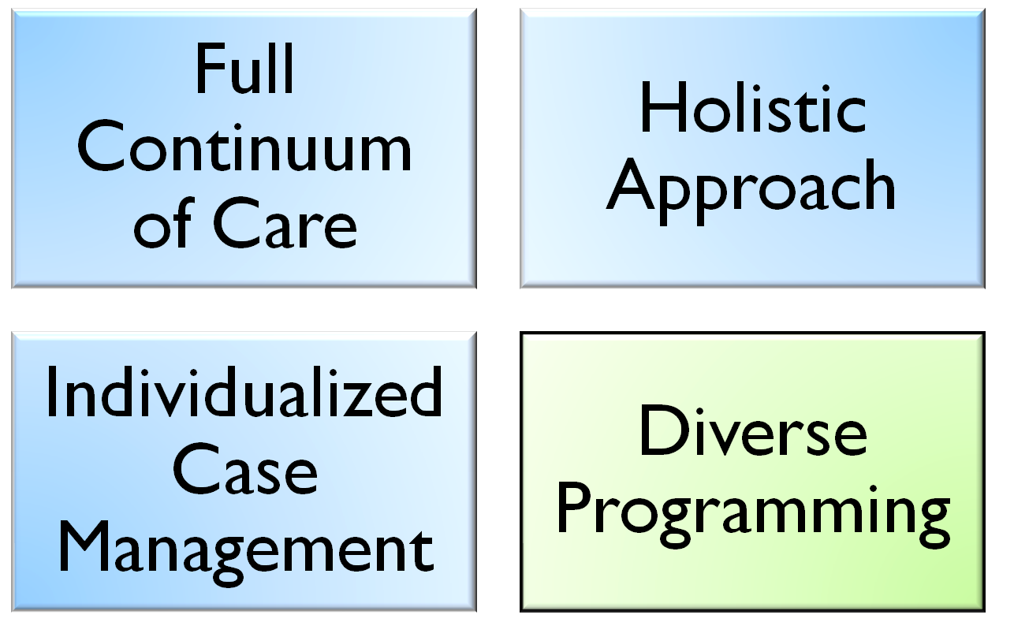
WHAT AURORA OFFERS

Slide 18
PARTIAL HOSPITALIZATION PROGRAM
-Support System Education
-Environmental Recommendations
-Group Therapy Customized to Individual Goals
-Adjunctive Therapy
-Medication Stabilization
-Neuropsychological
Evaluation
-Adult Only
- Track Options: Mental Health, Chemical Dependency OR Cooccurring
-5 Days/Week
-6 Hours/Day
-Avg LOS: 10 Days
Severe Mental Illness (SMI)
Suicidal & Homicidal Ideation
Detox & Substance Abuse
Mood Disorders (Depression, Bipolar)
Anxiety Disorders (General Anxiety, Panic Disorders, Agoraphobia )
Psychotic Symptoms (hallucinations, delusions, schizophrenia)
*Complimentary lunch and transportation assistance*
Notes:
--talk about nurses role
--see a doctor once/week

Slide 19
Intensive outpatient program
-Support System Education
-Environmental Recommendations
-Group Therapy Customized to Individual Goals
-Lower Level of Care
-Can Continue Normal Daily Activities
-Medication Stabilization
-Neuropsychological
Evaluation
-Adult AND Adolescent
- Track Options: Mental Health, Chemical Dependency OR Cooccurring
-3 Days/Week
-3 Hours/Session
-Avg LOS: 8 Weeks
Severe Mental Illness (SMI)
Suicidal & Homicidal Ideation
Detox & Substance Abuse
Mood Disorders (Depression, Bipolar)
Anxiety Disorders (General Anxiety, Panic Disorders, Agoraphobia )
Psychotic Symptoms (hallucinations, delusions, schizophrenia)
*Snacks/coffee and transportation assistance*
Notes:
-BE SURE TO NOTE THAT NOT EVERYONE GETS FREE TRANSPORTATION
--talk about patient satisfaction scores – on a scale of 1-5, 4.7 is avg overall score; when asked would you refer this program to a family member or friend, 4.9 say YES

Slide 20
Specialized Needs: Partial Hospitalization Program *coming soon*
More information to come

Slide 21
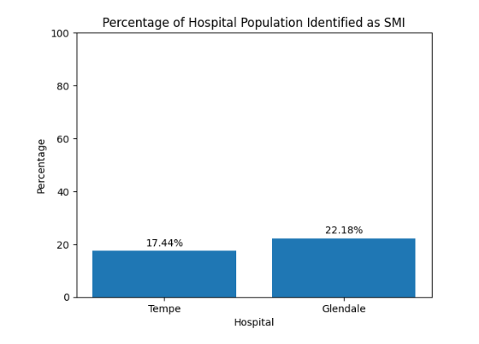
Percentage of Hospital Population Identified as SMI
12-01-2024 through 11-30-2025 (12 months)
Tempe
Total # of patients: 4,030
Total Primary Mercy Care RBHA SMI: 703
Glendale
Total # of patients: 3,837
Total Primary Mercy Care RBHA SMI: 851

Slide 22
Questions/Communications
What can we do to support your mission/vision?
If an issue is to come up, please feel free to reach out to me
I will connect you with the right person as soon as I can
  Erika.rudder@aurorabehavioral.com
  Text or call: 480-253-8982
  Katie.Rasmussen@aurorabehavioral.com
  QUESTIONS?

Slide 23
Event: A Day in the life at aurora behavioral Health
When?
  Glendale: Wednesday, February 11th (11am-1pm)
  Tempe: Tuesday, February 10th (11am-1pm)
See what “A Day in the Life” at Aurora Behavioral Health is like
Opportunity to have a run through of all of our adjunctive therapies we offer (equine, music, art, chaplains, etc)
Get the chance to connect with some of our staff

Slide 24


General Contact information
Aurora East
6350 S. Maple Ave.
Tempe, AZ 85283
(The hospital is located on the NW corner of Guadalupe and Maple, between Kyrene and Rural Rd.)
Main
480.345.5400
Aurora West
6015 W. Peoria Ave.
Glendale, AZ 85302
(The hospital is located ¼ west of 59th Ave. & Peoria on the south side of the street.)
Main
623.344.4400
24/7 Patient Services Helpline
480.345.5420
www.auroraarizona.com
Notes:
--talk about 24-hour helpine
--discuss provider direct referral line

